Slide 1


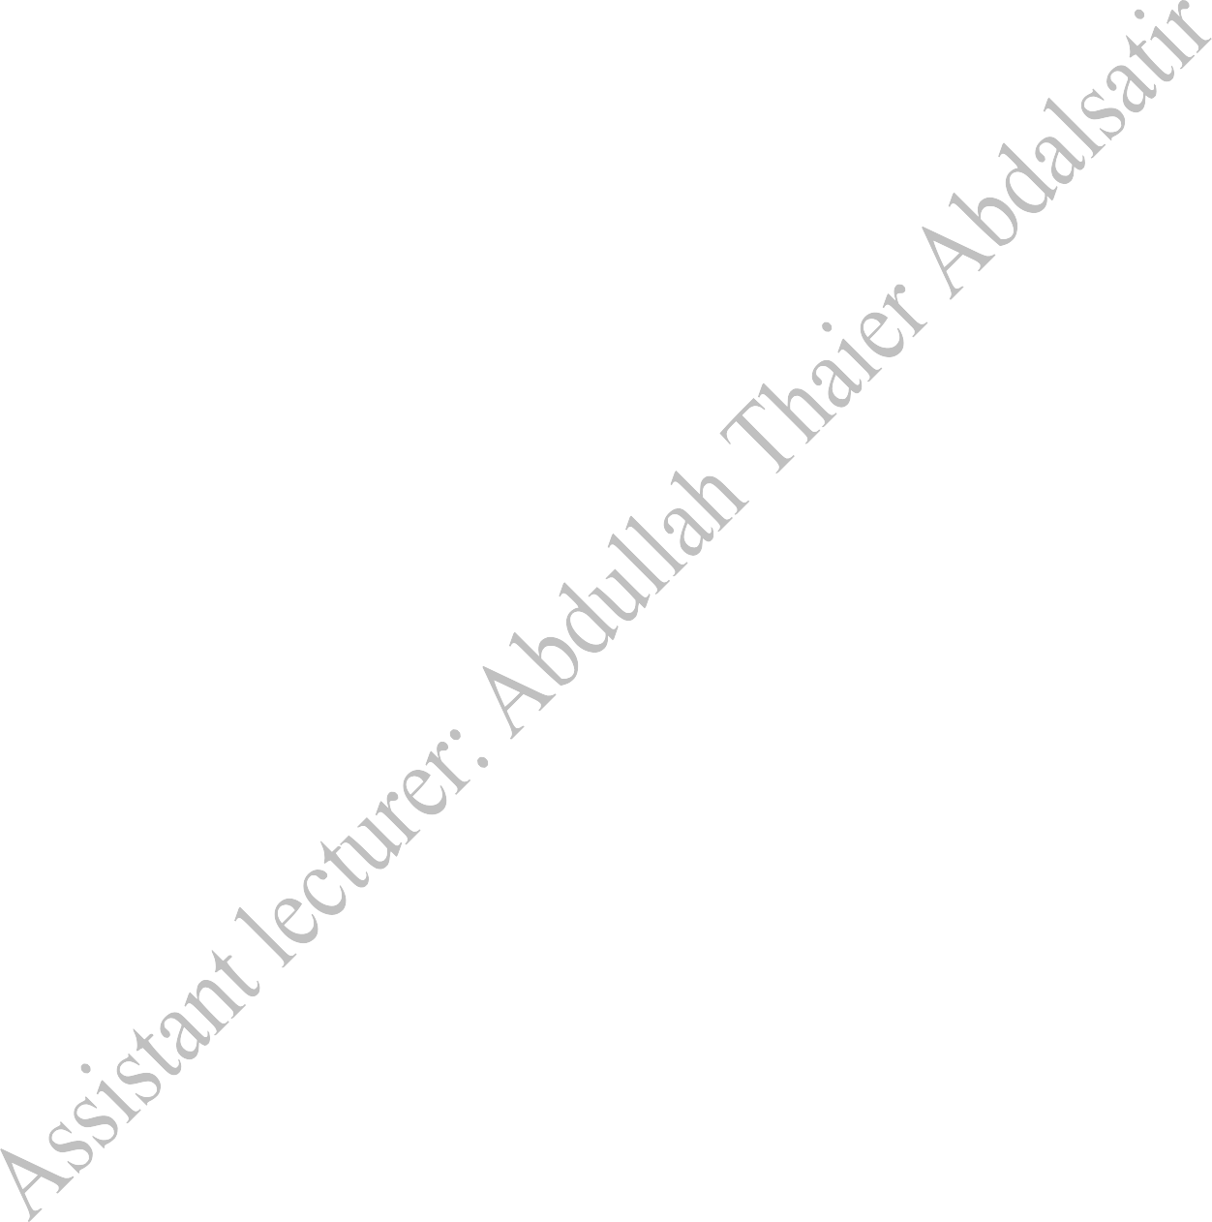
Diyala university College of engineering Department of computer
engineering
Second stage
Microprocessor
8086 Lab
Manual
µP
Microprocessor(8086) Laboratory Manual for Under-Graduate course in computerengineering.
Presented by :
Assistant lecturer: Abdullah Thaier Abdalsatir
1 | P a g e

Slide 2
Diyala university College of engineering
Department of computer engineering
Contents
1.a
1.b
1.c
1.d
Byte and word transfer in different addressing modes. Block transfer without overlap
Block transfer with overlap Block exchange
2.a.i
2.a.ii 2.b 2.c.i
2.c.ii 2.c.iii 2.c.iv 2.d 2.e.i
2.e.ii 2.e.iii 2.e.iv
2.e.v
2.e.vi
2.f.i
2.f.ii
16 bit Addition/Subtraction
32 bit Addition/Subtraction
ASCII adjust after Addition/Subtraction 16 bit Multiplication/Division
32 bit Multiplication
16-bit signed Multiplication Signed Division of word by a byte ASCIl adjust after Multiplication Square of a word
Cube of a byte Cube of a word
LCM of two numbers
HCF of two numbers Factorial of a number Binary to BCD conversion BCD to Binary conversion
3.a
3.b
3.c
3.d
3.e
Bit manupilation to check if the data ispositive or negative Bit manupilation to check if the data isodd or even
Bit manupilation to count the number of 1's and 0's in given data Bit wise Palindrome
Bit manupilation to check 2 out of 5 code
4.i 4.ii 4.iii
Addition/Subtraction of array of words Largest/Smaliest element in an array
Sorting array in Ascending/Descending order
5.i 5.ii 5.iii 5.iv 6
String transfer String reverse
Character search in a string Palindrome in a String
Display string on console using DOS interrupts
Interfacing Programs
1
2
3
4
Matrix Keyboard Interfacing LCD Interface
Logical Controller
Stepper Motor Interface

Slide 3
Diyala university College of engineering
Department of computer engineering
Execution of 8086 programs.
Run command prompt and go to Masm directory
i.e. C:\masm\
Type the program by opening an editor using Edit command
i.e. C:\masm\edit filename.asm
After typing the program assemble the program using masm command.
i.e. C:\masm\masm filename.asm;
After assembling, link the file using link command
i.e. C:\masm\link filename.obj;
Finally use debug or afdebug command to execute the program.
C:\masm\debug filename.exe
-t ; for single step execution
-g ; for at a time execution
-I ; for restarting the program execution
-d ; to see the data segment
-q ; to quit the execution
C:\masm\afdebug filename.exe
F1
g
L filename.exe Quit
; for single step execution
; for at a time execution
; to reload the program
; to come out of the execute screen

Slide 4
Diyala university College of engineering
Department of computer engineering
1.a.
Byte and word data transfer in different addressing modes
.MODEL SMALL
.DATA
Array DB 5 DUP (0) DB 78h
DB 20 DUP (0)
.CODE
MOV AX,@DATA MOV DS,AX
MOV BX, offset Array MOV SI,05h
MOV CL,[BX+SI] MOV SI,11H MOV [BX+SI],CL
MOV AH,4Ch INT 21h
END

Slide 5
Diyala university College of engineering
Department of computer engineering
1.b.i
Block transfer without overlap
.MODEL SMALL
.DATA
Array1 DW 1111h,2222h,3333h,4444h,5555h Array2 DW 5 DUP (0)
Count DW 0005H
.CODE
MOV AX,@DATA MOV DS,AX
LEA SI,Array1 LEA DI,Array2 MOV CX,Count
NEXT:
MOV AX,[SI] MOV [DI],AX INC SI
INC SI INC DI INC DI
LOOP NEXT
MOV AH,4Ch INT 21h
END

Slide 6
Diyala university College of engineering
Department of computer engineering
1.b.ii
Block transfer with overlap
.MODEL SMALL
.DATA
Array DB 11h,22h,33h,44h,55h Count DW 0005h
.CODE
MOV AX,@DATA MOV ES,AX MOV DS,AX
LEA SI,Array
ADD SI,Count MOV CX,Count DEC SI
MOV DI,SI ADD DI,2h STD
REP MOVSB
MOV AH,4Ch INT 21h
END

Slide 7
Diyala university College of engineering
Department of computer engineering
1.c. Block exchange
.MODEL SMALL
.DATA
Array1 DW 1111h,2222h,3333h,4444h,5555h Array2 DW 1010h,2020h,3030h,4040h,5050h
Count DW 0005h
.CODE
MOV AX,@DATA MOV DS,AX
LEA SI,Array1
LEA DI,Array2 MOV CX,Count
NEXT:
MOV BX,[SI] MOV DX,[DI] XCHG BX,DX MOV [SI],BX MOV [DI],DX INC SI
INC SI INC DI INC DI
LOOP NEXT
MOV AH,4Ch INT 21h
END

Slide 8
Diyala university College of engineering
Department of computer engineering
2.a.i
16 bit Addition/Subtraction
.MODEL TINY
.CODE
MOV BX,1234h
MOV CX,7698h MOV AL,BL ADD AL,CL DAA
MOV DL,AL MOV AL,BL ADC AL,CH DAA
MOV DH,AL
; for subtraction replace with
; SUB AL,CL
; DAS
; SBB AL,CH
; DAS
MOV AH,4Ch INT 21h
END

Slide 9
Diyala university College of engineering
Department of computer engineering
2.a.ii
32 bit Addition/Subtraction
.MODEL SMALL
.DATA
Data1 DW 1234h Data2 DW 5555h Data3 DW 6789h Data4 DW 1111h Ans1 DW 0000h Ans2 DW 0000h
.CODE
MOV AX,@DATA MOV DS,AX MOV BX,Data2 ADD BX,Data4
MOV Ans1,BX MOV CX,Data1 ADC CX,Data3 MOV Ans2,CX
; for subtraction replace with
; SUB BX,Data4
; SBB CX,Data3
MOV AH,4Ch INT 21h
END

Slide 10
Diyala university College of engineering
Department of computer engineering
2.b.
ASCII adjust after Addition/Subtraction
.MODEL TINY
.CODE
MOV AH,00h MOV AL,39h ADD AL,31h AAA
ADD AX,3030h
; for subtraction replace with
; SUB AL,31h
; AAS
MOV AH,4Ch INT 21h
END

Slide 11
Diyala university College of engineering
Department of computer engineering
2.c.i
16 bit Multiplication/Division
.MODEL TINY
.CODE
MOV AX,1234h MOV BX,7698h ADD AL,31h MUL BX
MOV AH,4Ch INT 21h
END
; for Division replace with
; DIV BX

Slide 12
Diyala university College of engineering
Department of computer engineering
2.c.ii
32 bit Multiplication
.MODEL SMALL
.DATA
Low1 DW 5678h
High1 DW 1234h Low2 DW 5678h
High2 DW 1234h Ans1 DW ?
Ans2 DW ?
Ans3 DW ? Ans4 DW ?
.CODE
MOV AX,@Data
MOV DS,AX MOV AX,Low1 MUL Low2 MOV Ans1,AX MOV Ans2,DX MOV AX,Low1
MUL High2 ADD AX,Ans2 ADC DX,00h MOV Ans2,AX MOV Ans3,DX
MOV AX,High1 MUL Low2 MOV CX,AX MOV BX,DX MOV AX,High1
MUL High2 ADD BX, AX
ADC DX,00H ADD Ans2,CX ADC Ans3,BX ADC DX,00H MOV Ans4,DX MOV AH,4Ch INT 21h
END

Slide 13
Diyala university College of engineering
Department of computer engineering
2.c.iii
16-bit signed Multiplication
.MODEL TINY
.CODE
MOV AX,-1234h MOV CX,-0ABCAh IMUL CX
MOV BX, AX MOV AH, 4Ch INT 21h
END

Slide 14
Diyala university College of engineering
Department of computer engineering
2.c.iv
Signed Division of word by a byte
.MODEL TINY
.CODE
MOV DX,-0ABCh MOV AX, 1234h MOV BX, 2334h
IDIV BX MOV CX,AX
MOV AH, 4Ch INT 21h
END

Slide 15
Diyala university College of engineering
Department of computer engineering
2.d.
ASCII adjust after Multiplication
.MODEL TINY
.CODE
MOV AL,OFh MOV BL,04h MUL BL
AAM
ADD AX,3030h MOV AH,4Ch INT 21h
END

Slide 16
Diyala university College of engineering
Department of computer engineering
2.e.i
Square of a word
.MODEL SMALL
. DATA
Number DW OFFFFh Ans DW 2 DUP (?)
.CODE
MOV AX,@DATA MOV DS, AX MOV DX, OOh
MOV AX, Number MUL Number MOV Ans, AX MOV Ans+2, DX MOV AH, 4Ch
INT 21h
END

Slide 17
Diyala university College of engineering
Department of computer engineering
2.e.ii Cube of a byte
.MODEL SMALL
. DATA
Number DB OFFh Ans DW 2 DUP (0)
.CODE
MOV AX,@DATA MOV DS, AX MOV AX, 0000h
MOV DX, 0000h MOV CX, 0000h
MOV CL, Number MOV AL, CL
MUL CL
MUL CX MOV Ans, AX
MOV Ans+2, DX MOV AH, 4Ch INT 21h
END

Slide 18
Diyala university College of engineering
Department of computer engineering
2.e.iii Cube of a word
.MODEL SMALL
. DATA
NUMBER DW 05566h CUBE DW 3 DUP (0)
.CODE
MOV AX,@DATA MOV DS, AX MOV DX, 00h
MOV AX, NUMBER MUL NUMBER MOV BX, DX
MOV DX, 00h MUL NUMBER MOV CUBE, AX MOV CUBE+2, DX
MOV AX, BX MUL NUMBER ADD AX, CUBE+2 ADC DX, 00h
MOV CUBE+2, AX MOV CUBE+4, DX MOV AH, 4Ch INT 21h
END

Slide 19
Diyala university College of engineering
Department of computer engineering
2.e.iv
LCM of two numbers
.MODEL SMALL
.DATA
Num1 DW 0005h Num2 DW 0002h
Ans DW ?
.CODE
MOV AX,@DATA MOV DS, AX
MOV AX, Num1 MOV BX, Num2 MOV DX, 0000h PUSH AX
PUSH DX DIV BX
CMP DX, 0000h
JZ LAST POP DX POP AX
ADD AX, Num1
JNC NEXT INC DX JMP NEXT POP Ans+2
POP Ans
NEXT:
LAST:
MOV AH, 4Ch INT 21h
END

Slide 20
Diyala university College of engineering
Department of computer engineering
2.e.v
HCF of two numbers
.MODEL SMALL
.DATA
Num1 DW 0005h Num2 DW 0002h
Ans DW ?
.CODE
MOV AX,@DATA MOV DS, AX
MOV AX, Num1 MOV BX, Num2 CMP AX, BX
JA NEXT XCHG AX, BX
MOV DX, 0000h DIV BX
CMP DX, 0000h JE LAST
MOV AX, DX JMP FIRST MOV Ans, BX
FIRST:
NEXT:
LAST:
MOV AH, 4Ch INT 21h
END

Slide 21
Diyala university College of engineering
Department of computer engineering
2.e.vi
Factorial of a number
.MODEL SMALL
.DATA
Number DB 08h Ans DW 0000h
.CODE
MOV AX,@DATA MOV DS, AX
MOV CH, 00h
MOV AL, Number MOV BL, AL
MOV CL, AL SUB CL, 02h DEC BL
MUL BL LOOP NEXT MOV Ans, AX
NEXT:
MOV AH, 4Ch INT 21h
END

Slide 22
Diyala university College of engineering
Department of computer engineering
2.f.i
Binary to BCD conversion
.MODEL SMALL
.DATA
Binary DB 63h
Ans DB 00h, 00h, 00h
.CODE
MOV AX,@DATA MOV DS, AX MOV AX, 00h
MOV AL, Binary
MOV CL, 64h DIV CL
MOV BCD, AL MOV AL, AH MOV AH, 00h
MOV CL, 0Ah DIV CL
MOV Ans+ 1, AL MOV Ans+2, AH
OR Ans, 30h
OR Ans+ l,30h OR Ans+2,30h
MOV AH, 4Ch INT 21h
END

Slide 23
Diyala university College of engineering
Department of computer engineering
2.f.ii
BCD to Binary conversion
.MODEL SMALL
.DATA
BCD DB 15h
Ans DB 00h
.CODE
MOV AX,@DATA MOV DS, AX
MOV AL, BCD ANDAL, 0Fh MOV BL, AL MOV AL, BCD ANDAL, 0F0h MOV CL, 04h ROR AL, CL MOV CL, 0Ah MUL CL
ADD AL, BL MOV Ans, AL
MOV AH, 4Ch INT 21h
END

Slide 24
Diyala university College of engineering
Department of computer engineering
3.a.
Bit manupilation to check if the data is positive or negative
.MODEL SMALL
.DATA
Msg1 DB ‘ENTERED NUMBER IS POSITIVE. $’ Msg2 DB ‘ENTERED NUMBER IS NEGATIVE. $’
Input DB ?
.STACK
.CODE
MOV AX, @Data MOV DS, AX
MOV AL, Input
ROL AL, 01h JC NEXT
LEA DX, Msg1 MOV AH, 09h INT 21h
JMP LAST
NEXT:
LEA DX, Msg2 MOV AH, 09h INT 21h
LAST:
MOV AH, 4Ch INT 21h
END

Slide 25
Diyala university College of engineering
Department of computer engineering
3.b.
Bit manupilation to check if the data is odd or even
.MODEL SMALL
.DATA
Msg1 DB ‘ENTERED NUMBER IS ODD. $’
Msg2 DB ‘ENTERED NUMBER IS EVEN. $’
Input DB ?
.STACK
.CODE
MOV AX, @Data MOV DS, AX
MOV AL, Input
SAR AL, 01h JC NEXT
LEA DX, Msg2 MOV AH, 09h INT 21h
JMP LAST
NEXT:
LEA DX, Msg1 MOV AH, 09h INT 21h
LAST:
MOV AH, 4Ch INT 21h
END

Slide 26
Diyala university College of engineering
Department of computer engineering
3.c.
Bit manupilation to count the number of 1’s and 0’s in given data
.MODEL SMALL
.CODE
MOV CX, 0008h MOV AL, 24h MOV BL, 00h MOV DL, BL
NEXT: SAR AL, 01h
JC DOWN INC BL LOOP NEXT JMP LAST
DOWN: INC DL
LOOP NEXT
LAST: MOV AH, 4Ch INT 21h
END

Slide 27
Diyala university College of engineering
Department of computer engineering
3.d.
Bit wise Palindrome
.MODEL SMALL
.DATA
Msg1 DB ‘GIVEN BYTE IS PALINDROME $' Msg2 DB ‘GIVEN BYTE IS NOTPALINDROME $'
Input DB ?
.CODE
MOV AX,@DATA
MOV DS, AX
MOV BL, Input MOV CX, 0008h MOV DL, BL
UP:
ROL BL, 01h RCL DL, 01h LOOP UP
CMP BL, DL JZ NEXT
LEA DX, Msg2 MOV AH, 09h INT 21h
JMP LAST
NEXT:
LEA DX, Msg1 MOV AH, 09h INT 21h
LAST:
MOV AH, 4Ch INT 21h
END

Slide 28
Diyala university College of engineering
Department of computer engineering
3.e.
Bit manupilation to check 2 out of 5 code
.MODEL SMALL
.DATA
Num DB 13h
Dis1 DB ' GIVEN BYTE IS A 2 OUT OF 5 CODE $' Dis2 DB 'GIVEN BYTE IS NOT A 2 OUT OF 5 CODE $'
.CODE
MOV AX,@DATA MOV DS, AX
MOV AL, Num TEST AL, 0E0h JNZ LAST MOV CX, 05h MOV AH, 00h
REPEAT: ROR AL, 01h
JNC SKIP INC AH
SKIP: LOOP REPEAT
CMP AH, 02h JNE LAST LEA DX, Dis1 JMP DISP LEA DX, Dis2
MOV AH, 09h
INT 21h
LAST: DISP:
MOV AH, 4Ch INT 21h
END

Slide 29
Diyala university College of engineering
Department of computer engineering
4.i Addition/Subtraction of array of words
.MODEL SMALL
.DATA
Array DW 1234h, 5678h, 9ABCh, 0DEF0h, 0AA11h
Count DW 0005h
Result DW 0000h, 0000h
.CODE
MOV AX,@DATA MOV DS, AX
MOV DX, 00h
MOV CX, Count DEC CX
LEA SI, Array MOV BX, [SI]
NEXT:
INC SI INC SI
ADD BX, [SI]
JC LAST LOOP NEXT INC DX LOOP NEXT
MOV Result, BX MOV Result+2, DX
; for subtraction replace with
; SUB BX,[SI]
LAST:
MOV AH, 4Ch INT 21h
END

Slide 30
Diyala university College of engineering
Department of computer engineering
4.ii
Largest/Smallest element in an array
.MODEL SMALL
.DATA
Array DB 10h, 20h, 30h, 40h, 50h Count DW 0005h
Result DB 00h
.CODE
MOV AX,@DATA MOV DS, AX
LEA SI, Array DEC Count MOV CX, Count MOV AL, [SI]
NEXT:
INC SI
CMP AL, [SI]
JC DOWN LOOP NEXT JMP LAST XCHG AL, [SI] LOOP NEXT
MOV Result, AL
; for smallest replace with
; JNC DOWN
DOWN:
LAST:
MOV AH, 4Ch INT 21h
END

Slide 31
Diyala university College of engineering
Department of computer engineering
4.iii
Sorting array in Ascending/Descending order
.MODEL SMALL
.DATA
Array DW 2233h, 8899h, 6677h, 0011h, 4455h
Count DW 0005h
.CODE
MOV AX, @DATA MOV DS, AX
 | MOV CX, Count LEA SI, Array
NEXT: | MOV BX, [SI] INC SI INC SI CMP BX, [SI] | ; for descending orderreplace with
 | JNC DOWN LOOP NEXT | ; JC DOWN
DOWN: XCHG BX, [SI] DEC SI
DEC SI
MOV [SI], BX LOOP NEXT
MOV AH, 4Ch INT 21h
END

Slide 32
Diyala university College of engineering
Department of computer engineering
5.i String transfer
.MODEL SMALL
.DATA
String1 DB 'BMSCE DEPT OF ECE$'
Length EQU ($-String1)
String2 DB LEN DUP (0)
.CODE
MOV AX, @DATA MOV DS, AX MOV ES, AX
MOV CX, Length CLD
LEA SI, String1 LEA DI, String2 REP MOVSB
MOV AH, 4Ch INT 21h
END

Slide 33
Diyala university College of engineering
Department of computer engineering
5.ii
String reverse
.MODEL SMALL
.DATA
String DB 'BMSCE$' Length EQU ($-String) Rvrs DB Length DUP (0)
.CODE
MOV AX,@DATA MOV DS, AX MOV ES, AX
MOV CX, Length
LEA SI, String+Length-1 LEA DI, Rvrs
REPEAT: MOV AL, [SI]
MOV [DI], AL DEC SI
INC DI
LOOP REPEAT
MOV AH, 4Ch INT 21h
END

Slide 34
Diyala university College of engineering
Department of computer engineering
5.iii
Character search in a string
.MODEL SMALL
.DATA
String DB 'BMS COLLEGE'
Length EQU ($-String)
Key DB 'X'
Dis1 DB '-IS PRESENTIN GIVEN STRING$'
Dis2 DB '-IS NOT PRESENTIN GIVEN STRING$'
.CODE
MOV AX,@DATA
MOV DS, AX MOV ES, AX
MOV DL, Key MOV AH, 02h INT 21h
LEA DI, String MOV AL, Key
MOV CX, Length
REPNE SCASB
JE PRESENT LEA DX, Dis2
CALL Display JMP OVER
PRESENT: LEA DX, Dis1
CALL Display
OVER: MOV AH, 4Ch INT 21h
Display PROC NEAR
MOV AH, 09h INT 21h
RET
Display ENDP
END

Slide 35
Diyala university College of engineering
Department of computer engineering
5.iv
Palindrome in string
.MODEL SMALL
.DATA
String DB 'BMSCE$'
Length EQU ($-String) Rvrs DB 30 DUP(0)
Dis1 DB '-IS NOTA PALINDROME$' Dis2 DB '-IS A PALINDROME$'
.CODE
MOV AX,@DATA
MOV DS, AX MOV ES, AX
MOV CX, Length
LEA SI, String+Length-1 LEA DI, Rvrs
MOV AL, [SI] MOV [DI], AL DEC SI
INC DI
LOOP REPEAT
REPEAT:
LEA DX, String CALL Display
LEA SI, String LEA DI, Rvrs MOV CX, Length REPE CMPSB JNZ NO
LEA DX, Dis2
CALL Display JMP OVER
NO:
LEA DX, Dis1
CALL Display
OVER:
MOV AH, 4Ch

Slide 36
Diyala university College of engineering
Department of computer engineering
INT 21h
Display PROC NEAR
MOV AH, 09h INT 21h
RET
Display ENDP
END
6. Display string on console using DOS interrupts
.MODEL SMALL DATA SEGMENT
MSG DB ‘BMSCE ECE DEPT$’ DATA ENDS
CODE SEGMENT
MAIN PROC FAR ASSUME CS: CODE, DS: DATA
START: PUSH DS
XOR AX, AX PUSH AX
MOV AX, DATA
MOV DS, AX MOV AH, 09h
MOV DX, OFFSETMSG INT 21h
RET END START
MAIN ENDP CODE ENDS

Slide 37
Diyala university College of engineering
Department of computer engineering
Interfacing the 8086 processor.
Run command prompt and go to Masm directory
i.e. C:\masm\
Type the program by opening an editor using Edit command
i.e. C:\masm\edit filename.asm
After typing the program assemble the program using masm command.
i.e. C:\masm\masm filename.asm;
After assembling, link the file using link command
i.e. C:\masm\ link filename.obj;
Convert the executable file to binary program.
i.e. C:\masm\ exe2bin filename.exe
Convert the binary file to hex program.
i.e. C:\masm\bin2hex filename.exe
Open the hex uploader program.
i.e. C:\masm\mmeterm
Set the Baud rate to 9600bits/second.
i.e. 5. Configuration> 1. Baud Rate>5. 9600
Press reset on the interface kit.
Message will appear on the LCD as uP 8086.
Press Download on the interface kit to prepare the processor to receive file.
Message will appear on the LCD as Reading RS 232.
Send file to the processor via serial port [COM1].
i.e. 3. Sendfile>Which File? filename.hex
Press Enter
Message will appear on the LCD as Data received.

Slide 38
Diyala university College of engineering
Department of computer engineering
1. Matrix Keyboard Interfacing
CODE SEGMENT
ASSUME CS:code,DS:code,ES:code,SS:code CWR EQU 46h
PORTA EQU 40h PORTB EQU 42h PORTC EQU 44h
ORG 0400h MOV AL, 88h OUT CWR,AL
; port a and port c high as output
; port b and port c low as output
READKEY:
MOV DL,0 MOV AL,0F0h OUT PORTC,AL
; clear e/dl register
; output all one's to pc high
LP:
IN AL,PORTC ANDAL,0F0h CMP AL,0F0h JNZ LP
CALL FAR PTR ONEMS
KEYCHK:
IN AL,PORTC ANDAL,0F0h CMP AL,0F0h JZ KEYCHK
CALL FAR PTR ONEMS MOV AL,7Fh
MOV BH,04h
;wait for key press
NXTCOLM:
ROL AL, 01h MOV DH,AL OUT PORTC,AL IN AL,PORTC ANDAL,0F0h MOV CL,04h
; scan each column
; and wait for the data
; in any of the four
; rows
NXTROW:
ROL AL,01h JNC CODEN INC DL
DEC CL
JNZ NXTROW MOV AL,DH DEC BH
JNZ NXTCOLM JMP KEYCHK
; scan each column
; scan each column
; in any of the four
; rows

Slide 39
Diyala university College of engineering
Department of computer engineering
CODEN:
MOV AL,DL MOV DH,0h
MOV BX,OFFSETLOOKUP+8000h ADD BX,DX
MOV AL,BYTE PTR[BX] OUT PORTB,AL
JMP READKEY
ONEMS:
; delay routine
PUSH AX MOV AL,0FFh
LOP:
DEC AL
JNZ LOP POP AX RETF
LOOKUP:
DB
DB CODE ENDS
00h,04h,08h,0Ch,01h,05h,09h,0Dh
02h,06h,0Ah,0Eh,03h,07h,0Bh,0Fh
END

Slide 40
Diyala university College of engineering
Department of computer engineering
2. LCD Interface
CODE SEGMENT
ASSUME CS:CODE,DS:CODE,ES:CODE DISINTEQU 21h
DSPBUF EQU 9E00h
ORG 400h MES1 DB 'BMSCE' MES2 DB 'OF E AND C' MES3 DB ' '
;maximum size of message can be 16 bytes
L1: | MOV SI,OFFSETMES3+8000h MOV DI,DSPBUF MOV CX,08h REP MOVSW INT DISINT CALL DELAY | ; move result format message ; to display buffer ; counterfor movs instruction ; counterfor movs instruction
 | MOV SI,OFFSETMES1+8000h | ; move result format message
 | MOV DI,DSPBUF | ; to display buffer
 | MOV CX,08h | ; counterfor movs instruction
 | REP MOVSW INT DISINT | ; move 8 words to display buffer
 | CALL DELAY
 | MOV SI,OFFSETMES2+8000h | ; move result format message
 | MOV DI,DSPBUF | ; to display buffer
 | MOV CX,08h | ; counterfor movs instruction
 | REP MOVSW | ; move 8 words to display buffer
 | INT DISINT
 | CALL DELAY
 | JMP L1
DELAY PROC NEAR
MOV AX,0FF00h AGAIN: DEC AX
JNZ AGAIN RET
DELAY ENDP CODE ENDS
END

Slide 41
Diyala university College of engineering
Department of computer engineering
3. Logical Controller
CODE SEGMENT
ASSUME CS:CODE,DS:CODE,SS:CODE,ES:CODE
ORG 0400h MOV AL, 89h OUT 46h,AL
AGAIN: IN AL, 44h
MOV BL, AL ANDAL, 0F0h MOV CL, 04h SHR AL,CL
ANDAL,BL
; replace with
; XOR AL,BL for XOR operation
; OR AL,BL for OR operation
ANDAL, 0Fh OUT 42h,AL JMP AGAIN
CODE ENDS END

Slide 42
Diyala university College of engineering
Department of computer engineering
4. Stepper Motor Interface
CODE SEGMENT
ASSUME CS:CODE,DS:CODE CWR EQU 46h
PORTA EQU 40h
ORG 400h
MOV AL,80h OUTCWR,AL
; send 09h,0Ah,06h,05h for
; anti-clockwise rotation
; send 05h,06h,0Ah,09h for
; clockwise rotation
AGAIN:
MOV AL,05h OUT PORTA,AL CALL DELAY
MOV AL,06h OUT PORTA,AL CALL DELAY
MOV AL,0Ah OUT PORTA,AL CALL DELAY
MOV AL,09h OUT PORTA,AL CALL DELAY
JMPAGAIN DELAY PROC NEAR
MOV CX, 0800h
BACK: DEC CX
JNZ BACK RET
DELAY ENDP
CODE ENDS END

